Slide 1

Uzbekistan's Digital Court Reform: Integrating AI into Civil Justice
By Abbosbek Ochilboev

Slide 2
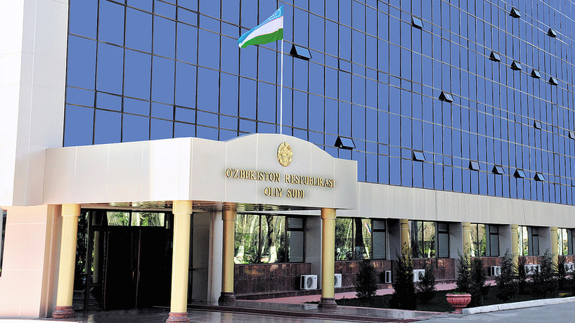
Why Structural Reform?
Access problem — most civil disputes never reach the courts
Consistency problem — anchoring and bias shape judicial outcomes
Procedural reform alone cannot fix this.

Slide 3
PART II / EVIDENCE
The Myth of the Rational Judge
Independent. Neutral. Unbiased.
Is this who decides?
FIVE STUDIES TEST THE ASSUMPTION
Hunger • Anchoring • Sleep • Elections • Race & Appearance
Each one moves outcomes. None appear in any code.
9

Slide 4
STUDY 1 / HUNGER
Hungry Judges and Parole Decisions
THE FINDING
SAMPLE
65% → 0%
More than 1,000 parole hearings before experienced Israeli judges.
CITATION
Danziger, S., Levav, J., & Avnaim-Pesso, L. (2011). Extraneous Factors in Judicial Decisions. PNAS 108(17), 6889–6892.
Parole approval rate from
right after a meal break
to right before the next one.
DOI: 10.1073/pnas.1018033108
TAKEAWAY
A prisoner's freedom turned, in part, on when the judge had eaten lunch.
10

Slide 5
STUDY 2 / ANCHORING
Anchoring on Random Numbers
THE FINDING
SAMPLE
+8 months
Experienced German trial judges sentencing in a fictional case.
CITATION
Englich, B., Mussweiler, T., & Strack, F. (2006). Playing Dice with Criminal Sentences. PSPB 32(2), 188–200.
Average sentence increase
when a weighted die was set
to a high number before sentencing.
DOI: 10.1177/0146167205282652
TAKEAWAY
If a die can move a sentence by months, what else is anchoring our judgments invisibly?
11

Slide 6
STUDY 3 / FATIGUE
Sleepy Punishers After Daylight Saving
THE FINDING
SAMPLE
+5%
U.S. federal sentencing data, comparing post-DST Mondays to other Mondays.
CITATION
Cho, K., Barnes, C. M., & Guanara, C. L. (2017). Sleepy Punishers Are Harsh Punishers. Psychological Science 28(2), 242–247.
Sentence length on the Monday
after the spring shift
to daylight saving time.
DOI: 10.1177/0956797616684004
TAKEAWAY
Tiredness, invisible to the courtroom, becomes years added to other people's lives.
12

Slide 7
STUDY 4 / ELECTIONS
Electoral Pressure on Sentencing
THE FINDING
SAMPLE
↑ harsher
Elected trial judges in Pennsylvania, criminal sentencing data over multiple election cycles.
CITATION
Huber, G. A., & Gordon, S. C. (2004). Accountability and Coercion: Is Justice Blind When It Runs for Office? AJPS 48(2), 247–263.
Sentences become harsher
as judicial elections approach,
then relax after the vote.
DOI: 10.1111/j.0092-5853.2004.00059.x
TAKEAWAY
The political calendar bends the line of justice. The defendant pays the cost.
13

Slide 8
STUDY 5 / IDENTITY
Race and Appearance in Sentencing
RACE
APPEARANCE
+19.1%
Lighter
Sentence length for Black men compared with similar White men, after controlling for many factors.
Defendants seen as more attractive tend to receive lighter sentences than less attractive defendants.
USSC (2017). Demographic Differences in Sentencing.
Downs, A. C., & Lyons, P. M. (1991). PSPB 17(5), 541–547.
ussc.gov/research/research-reports/demographic-differences-sentencing
DOI: 10.1177/0146167291175009
The body in the dock matters as much as the file in front of the judge.
14

Slide 9

Uzbekistan's Journey
2014 — E-SUD in all 89 civil courts
2018 — sud.uz citizen portal
2020 — automatic blind case distribution
2025 — Digital Court concept introduced
This Photo by Unknown Author is licensed under CC BY-SA-NC

Slide 10

The 2024–2025 AI Policy Package
National AI Strategy (Oct 2024)
Decree PF-140 / Digital Court (Aug 2025)
Law on AI (Nov 2025)

Slide 11

Five Structural Gaps
Legal framework
Procedural rules
Data protection & training data
Judicial independence & automation bias
Capacity, multilingualism, infrastructure

Slide 12

Comparative Lessons
China — deploy first, regulate later → don't
Singapore — sequence by case type
Estonia — communicate clearly; no "robot judge"
Brazil — AI for triage, not adjudication
Council of Europe — the regulatory benchmark

Slide 13
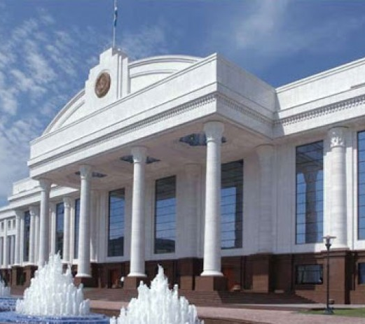
Seven Sequenced Directives

Slide 14

Conclusion

